Slide 1


SIEM Made Easy
Made with love for IT people
Notes:
Hi and thank you for joining. In this video we’re going to provide a very quick overview of Blumira and why we’re the right choice of SIEM when you need one, but don’t have a team of security engineers to run one.

Slide 2


HQ
Mission
Ann Arbor, MI
2018
Blumira Founded
SIEM/SOC
Advanced Threat Detection, Analysis, and Guided Response
VC-Backed 15M Series B
By making good security simple and affordable, we can help smaller organizations that have been neglected, priced-out, or, simply-failed-by existing solutions.
Notes:
Blumira was founded in Michigan in 2018 with the mission is to make good security simple and affordable by helping the smaller organizations that have been neglected, priced out, and simply failed by existing solutions.
Our whole goal is to help you get better at security not just to use our product.
SIEM, or Security Information and Event Management, is something that’s been used for decades at the enterprise level, because when used properly it truly does provide greater visibility to catch incidents before they become a breach. But it’s never been a useful tool at the SMB level, we’ll discuss why and how we’re changing that.

Slide 3
“Come for the Compliance. Stay for the Amazing SecOps Support”
Where Blumira Fits In Your Stack
Impending Mandatory Requirement:
Log Monitoring, Management, 1YR+ Retention
Ultimate Goal: Advanced Detection, Analysis and Guided Response to Prevent Ransomware with 24/7 SecOps Support
Notes:
Blumira has made a SIEM platform that actually works for IT Admins and doesn’t need a dedicated security team to run it. A crazy thought, right?
Blumira is a cloud SIEM platform backed by the Blumira security operations team available 24/7 for urgent incidents to help with detection and response. Blumira enables small IT and Security teams to protect their data, networks, and applications with faster detection and prevention of attacks like ransomware. Our platform meets the log monitoring and one-year retention requirements for cyber insurance and industry regulations.

Slide 4
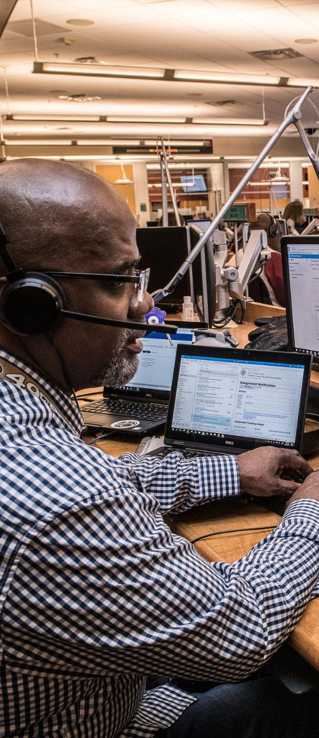
SMB PROBLEMS
“I don’t have the staff dedicated to sit and read logs all day or with the skillset to analyze our data.”
“We can’t monitor all of our logs — we would need a team of 100 to go through all of these logs manually.”
“Other tools are noisy; we don't have time to dig through layers and layers of data.”
SMBs need SIEM, detection & response to meet compliance – but tools today fail them.
TOO COMPLEX
Security solutions are built for large enterprises with big teams
Require add'l infrastructure, security skills, months to get operational
Small teams stretched too thin between IT & security tasks
TIME SUCK
Too many logs and alerts to comb through to find real threats delays critical response time
REALLY CRAPPY TOOLS
‹#›
Notes:
Historically, SIEMs are too complex, it takes months to set up and constant tuning. They’ve always been made by security professionals, for security professionals, which makes them really crappy tools for IT professionals.
If you don’t have a team of security experts, don’t even bother.

Slide 5





But Alas, SIEM is Becoming a Necessity
HIPAA, PCI, CMMC, CIS and others have required log collection, monitoring, and retention for years and the Insurance mandates are on the way too.
Cyber Insurance Questionnaires:
Does the applicant utilize a Security Information and Event Management system (SIEM)?
Does the Applicant have centralized log collection and management that allows for
review of all access and activity on the network?
For how long are logs maintained?
Compliance:
CIS
Notes:
But like it or not, SIEM is becoming a necessity from multiple different directions.
I doubt you’re watching this video simply because it’s always been your greatest desire to deploy a SIEM in all your spare time, but you likely understand that the simple reality is that soon, you’re going to have to. And if you have to, might as well choose one that doesn’t suck!
SIEM, and Log retention and monitoring are already being tied to premium costs in Cyber insurance. Before we know it, you won’t be insurable without it.
-------

Slide 6
Cyber Insurance Topics Blumira Helps With
(Depending on Carrier Definitions)
✓ SIEM - Advanced Detection and Response
✓ Log Monitoring and 1 Year Retention
✓ SOC - 24/7 Support
✓ Endpoint Detection and Response with Monitoring
✓ Endpoint Isolation and Containment
✓ Advanced Threat Protection
✓ Network Monitoring
✓ Privileged Access Management Monitoring
“We need to have a SIEM tool for our SOC 2 Type II compliance and to ensure we're properly flagging suspicious activity that only really shows up in logs and with some analysis services. This really is a tool for SMBs who also have compliance and regulatory concerns.”
-John Snyder
CEO at Net Friends
www.blumira.com/compliance
‹#›
Notes:
Speaking of insurance, here are some of the many things we help with that insurance is requiring or at least asking about depending on the carrier.
At blumira.com/compliance you’ll find REAL questions from REAL insurance applications and our suggested responses to those questions if you were using Blumira.

Slide 7
03
How
Blumira
Works
Notes:
So, how does Blumira work?

Slide 8














How Blumira Works
Send logs to Blumira
2. Analysis, Detections
3. Guided Response
Blumira Agent
Cloud Connectors
Sends Security Finding
SecOps Team
Blumira Sensor (VM)
Step-by-step Playbook Response
Threat Hunting
Detections
Threat Intel
Notes:
Setting up Blumira is easy and straightforward. You simply follow our documentation to get all of the logs from your tools up to Blumira. You do so through a combination of of up to three methods.
The Blumira Agent gathers Windows logs and sends them over the internet from wherever the device may be.
You can use APIs to set up cloud connectors to create cloud-to-cloud connections for us to pull data into Blumira
And you can use our Blumira Sensor, a Linux VM that sits behind the firewall to collect firewall logs and to serve as a honeypot.
<Click> Once the data hits the Blumira cloud, we do everything necessary to make the solution valuable from a security perspective. We subscribe to all the threat intel feeds, we do the threat hunting that results in new detections, we tune and groom those detections constantly to ensure they’re actionable.
<Click> When you get reports from us, our findings enable you to respond using detailed analysis and step by step guided responses or we’ll be there to help you through it as the case may be.

Slide 9
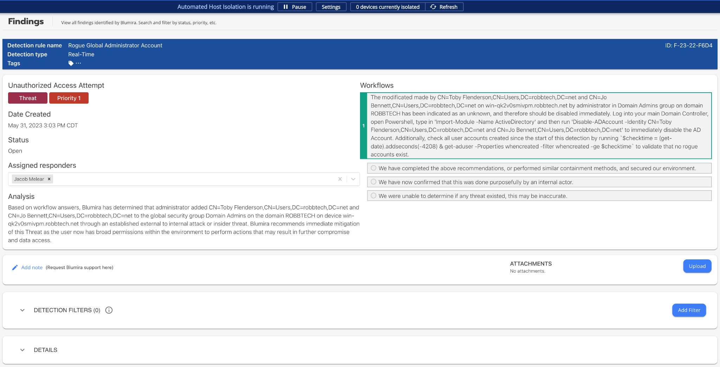
Example Finding
Notes:
With every one of our findings… <CLICK>
You see the rule name, the threat level and priority to understand the criticality.
There’s a detailed analysis written so that an IT person can understand
We provide a workflow playbook that guides you to a remediation. (No security expertise required)
If you need help or more information, you can interact with Blumira’s SecOps team directly in the finding for advice
If needed, you can filter out exceptions to reduce noise
And we provide the log level detail

Slide 10
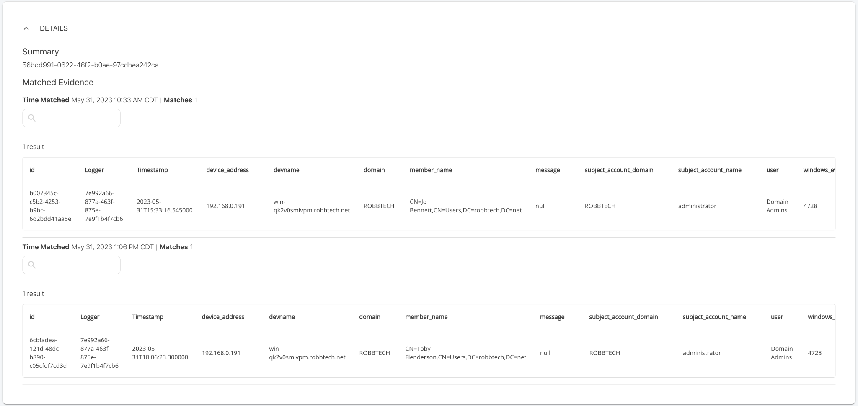
Example Finding - Matched and Stacked Evidence
Notes:
and match and stack evidence so you get one finding with hundreds of lines of matched evidence instead being flooded with hundreds of alerts with no context.

Slide 11
Discovery
Initial Access
Escalate Privileges
Execute Files
Exfiltrate Data
Ransomware
Complete Security Coverage
Detect & prevent every stage of an attack in progress with Blumira
Recon Scanning (Internal & Known Threat)
Password Spraying
Brute-Force Attacks
Admin Role Changes
New Admin Accounts
Compromised Processes
Malicious Executables
External Doc Shares
Outbound Connections
Malware Applications
Notes:
The simple reality is that you cannot protect what you cannot see. Getting log level visibility allows us to focus on coverage for all stages of an attack to help you respond faster to indicators of attacker activity so that incidents stay incidents before they get the chance to become a breach.

Slide 12
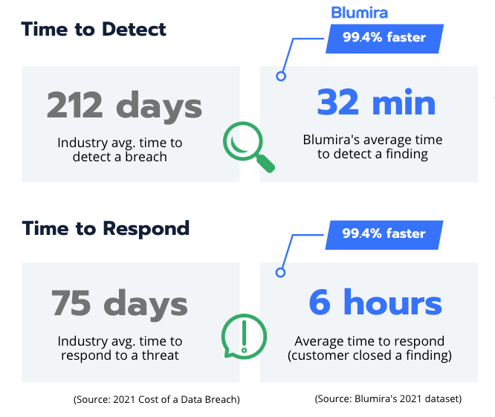
Blumira’s platform is highly effective, resulting in better security outcomes vs. competitors
Resources – staff, cost, infrastructure, time – required to set up and maintain it are lower than competitors
Notes:
We help take the time of detection from months to minutes
And the time of Response from days to hours.

Slide 13


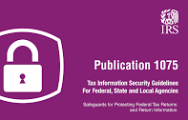
Help Meet Compliance With Blumira
Help meet requirements for logging, audit trails, log retention, threat detection, incident response and more
Cyber Insurance Log Auditing Requirements
NIST 800-53 & 800-171
FFIEC for financial applications
HIPAA to protect patient health info
PCI-DSS 3.2 to protect payment info
CJIS for criminal justice data
IRS Pub 1075 for tax data
Notes:
Let's face it, often times security budgets don’t become available until they absolutely have to.
Whether it’s cyber insurance, NIST, CMMC, or another compliance driver, Blumira not only helps meet the compliance objectives, but it actually makes you more secure, in a tool that's not a time-suck and easily manageable, and at a price that you can actually afford

Slide 14

With Blumira, SMBs realize greater security benefits:
"Blumira does the heavy lifting to pare down the overwhelming amount of data from logs into actionable events.
That allows us to focus on revenue-enhancing activities."
Michael Cross, Chief Information Officer
Greenleaf Hospitality
✓ TIME & RESOURCES SAVED
✓ BETTER RESPONSE TIMES
✓ IMPROVED THREAT DETECTION
✓ EASILY MEET COMPLIANCE & CYBER INSURANCE
On deployment, onboarding, integration setup, parsing, writing detection rules and manual security tasks; more time spent on strategic initiatives
Real-time detections delivered in 50 sec; prioritized alerts & 3-step response stop attacks in progress faster to prevent ransomware & breaches
Blumira’s detection engineers focus on threats other tools miss, researching and updating the platform regularly so SMBs don’t have to
Faster deployment, less resources and headcount needed to meet compliance & cyber insurance policy requirements for SIEM, log review, data retention, etc.
At a fraction of the cost of traditional SIEM Solutions
Notes:
In summary, Blumira helps you meet the compliance and insurance requirements that are becoming no longer avoidable.
In doing so, we provide real threat detection and actionable responses, saving your team time and money and keeping you insurable.
Engaging with us fully will not just result in a successful SIEM implementation, it will make your organization more secure over time as you remedy the issues that our platform will raise.
While our tool is great, it’s truly our Blumira team that makes the difference. In the SMB space, the security expertise has to come along with the tools. Our 24/7 SecOps team does all the security work so you can make quick decisions and get back to your objectives at hand.
Blumira is truly the SIEM you need, a a price that you can actually afford.

Slide 15
Free Trial of our entire Platform!
blumira.com/trial
Notes:
Now there’s no need to trust anything I say because we provide a free trial of our Entire platform. Get started by protecting your Windows devices and M365 in minutes with Blumira and see if it’s a good fit for your business. Easy, right?

