Slide 1



Proposal for:
[Company Name]
Prepared by:
<Insert Name>
Date: 10/17/2022
Advanced Security Made Accessible For All
Notes:
Image Source: https://www.pexels.com/search/server%20racks/?size=large&color=2196F3

Slide 2
Solution Summary
Blumira makes security simple to manage and affordable for SMBs. Blumira’s automated cloud SIEM and XDR platform is backed by a security operations team available 24/7 for urgent incidents to help with detection and response.
Our platform meets the log monitoring and one-year retention requirements for cyber insurance and compliance frameworks like NIST and CMMC. It provides greater security value than traditional SIEMs at an affordable cost and predictable pricing model.
We ease the burden of alert fatigue, the complexity of log management and lack of visibility across an IT environment. Blumira brings an integrated platform to companies in many different industries struggling to defend against cybersecurity attacks with limited resources and staff.
To better understand your team’s needs, we have conducted a proof of concept.
Blumira’s Proof of Concept
The objective of the proof of concept is for your team to perform due diligence on Blumira’s platform and to ensure that it is a good fit for your security team. The process is outlined below:
Demo/Discovery
Kickoff
Ongoing Trial
Conclusion
Uncover where Blumira may fit into your security team’s cybersecurity posture.
Blumira’s sales engineers help your team setup and deploy Blumira sensors on a limited scale.
Weekly check-ins to provide training, support, and to answer any questions not previously covered.
Conclusion of the proof of concept. Evaluation before implementation
Your point of contact is:
Name
Title
Email
Phone

Slide 3
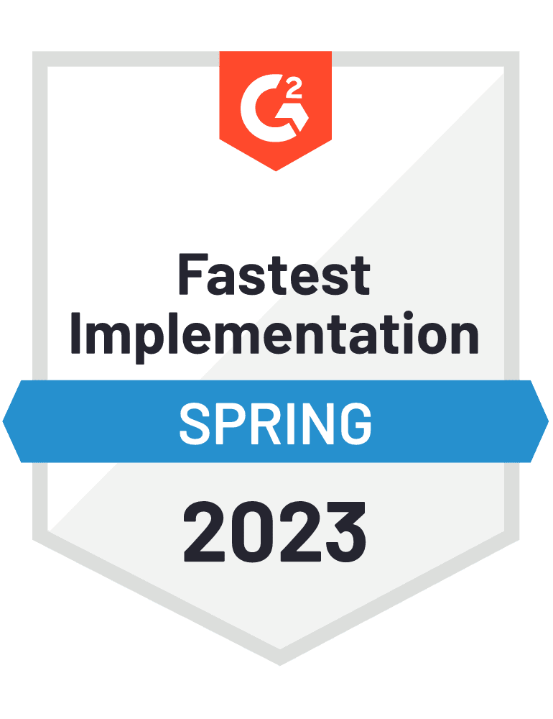
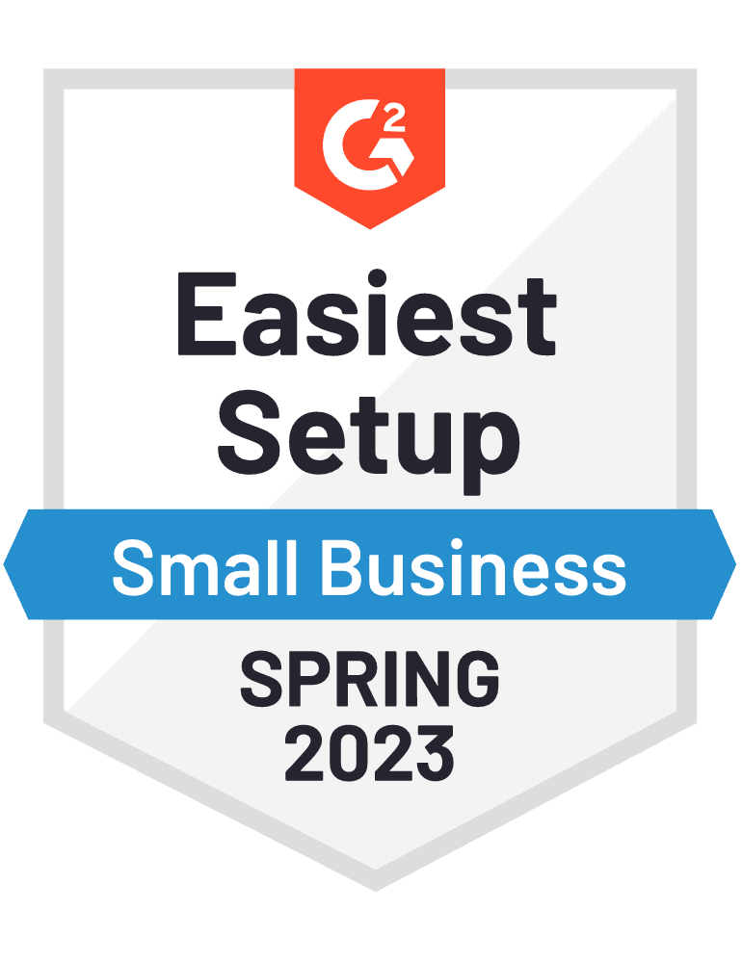
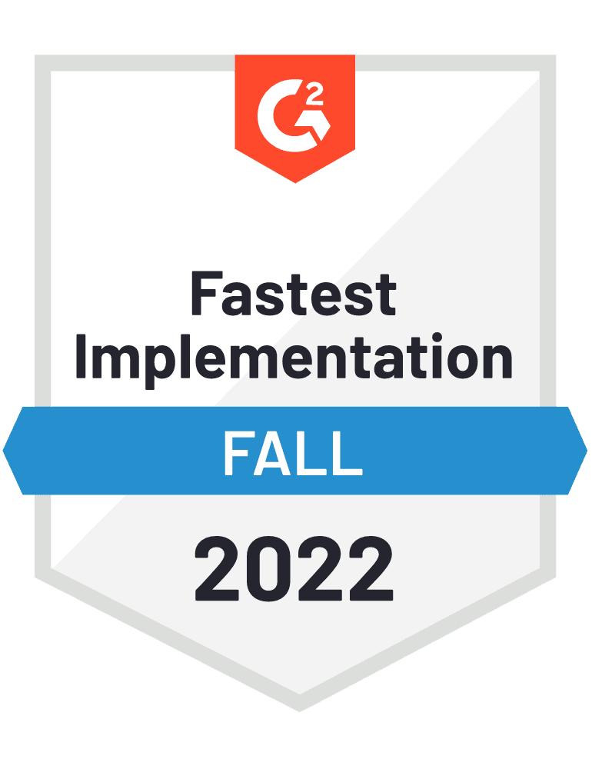



Implementation
Timeline
Blumira provides fast time to security. IT admins can deploy Blumira's platform within a single business day for broad on-premises & cloud coverage.
Week 1
Week 2
Mon
Tue
Wed
Thu
Fri
Mon
Tue
Wed
Thu
Fri
Deploy & Integrate
Log Ingestion
Tune Detections
Monitor
Continuous
Blumira’s time to deploy is 5x faster than the average SIEM provider. Our 50+ integrations provide coverage for your hybrid on-prem and cloud environment, and our dedicated Solutions Architects assist you with onboarding as needed to ensure your security success.
Our unique approach to detections notifies you of threats other security tools may miss, sending you real-time alerts in under a minute of initial detection to help you respond to threats faster than ever. Our platform sends high-priority, critical findings tuned by our security engineers to save your team the time of combing through alerts.
Learn more about our awards here
Your point of contact is:
Name
Title
Email
Phone

Slide 4
Pricing & Options Summary
Thank you for investing time in the discovery process to identify your needs and the best approach to your SIEM solution. We appreciate your investment into the process.
Below is the proposed solution for your company. Please review and reach out to me if you have any questions.
Detail on these services is provided in the following pages.
Blumira SIEM + Endpoint Edition
SIEM + Endpoint Edition | Pricing per User | Users | Discount (%) | Monthly Costs
No Discount, 1 Year Commitment | $18.00 | 400 | 0.00% | $7,200
Predictable Pricing
Blumira pricing is based on user (employee) count. We do not charge based on number of integrations, or data volume which allows you to easily understand and forecast costs.
Your point of contact is:
Name
Title
Email
Phone

Slide 5

Solution Detail
Blumira allows you to:
Collect & Centralize Security Events
Respond Quickly With Guided Playbooks
Easily integrate with applications and security tools across your environment, including cloud and on-prem. Blumira’s cloud-delivered service collects and parses security events, logs and alerts for visibility through a single pane of glass.
Easily integrate with applications and security tools across your environment, including cloud and on-prem. Blumira’s cloud-delivered service collects and parses security events, logs and alerts for visibility through a single pane of glass.
Rapidly Detect Cybersecurity Threats
Report on Security Findings & Activities
By correlating log data with continuously updated threat intelligence feeds, Blumira’s platform detects known and suspected cybersecurity threats. It reduces the noise of
false-positive alerts with automation and fine-tuning. With Blumira, you can deploy honeypots with the click of a button to detect lateral movement and unauthorized access across your environment.
Blumira’s pre-built and scheduled reports help organizations investigate the security threats found within their environment while providing auditors with reports to help
meet compliance.
Automate Threat Response
When known cybersecurity threats are detected, Blumira’s service allows you to easily implement blocking rules and isolate affected devices to quickly stop active threats without manual intervention.
“We have been looking for a SIEM and a monitoring tool for our M365 and other cloud products and Blumira helps us with that right out of the box. It gives us just the right level of visibility we need for our SMB customers.”
Corey Kirkendoll, CEO, 5k Technical Services
Your point of contact is:
Name
Title
Email
Phone
Notes:
Image Source: https://www.pexels.com/photo/a-group-of-people-having-a-meeting-in-the-office-5946222/

Slide 6


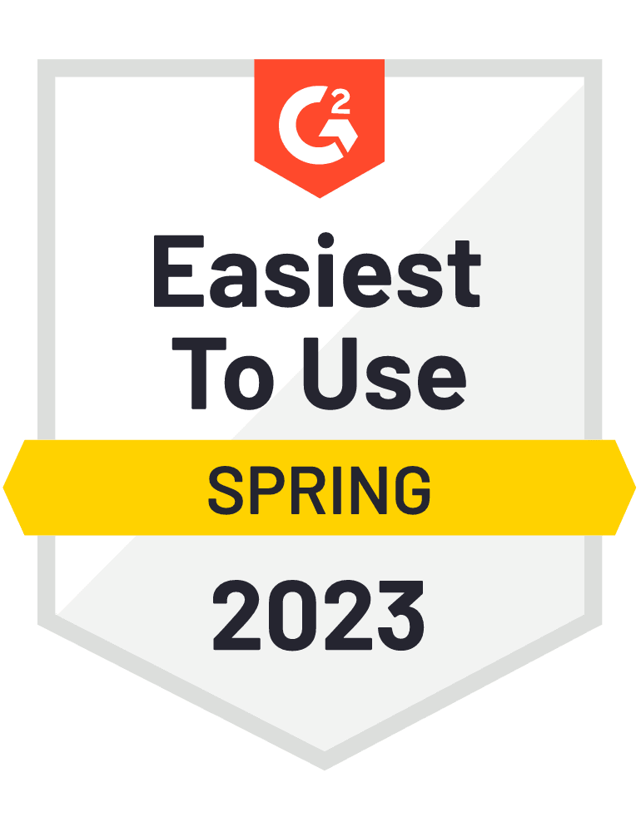
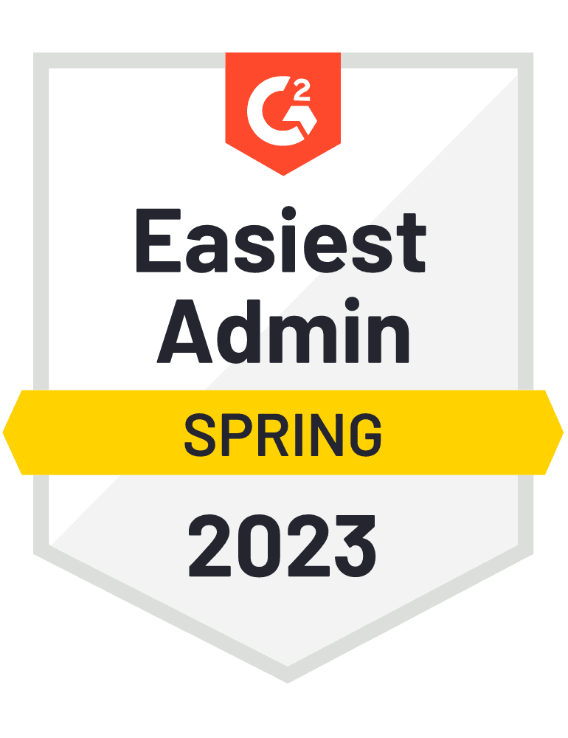
Customers Love Blumira
Here’s what our customers have to say about Blumira’s award winning product and support.
“I don’t have the staff dedicated to sit and read logs all day or with the skillset to analyze our data. We chose Blumira for its simplicity – I needed a solution that would simplify, consolidate and show me what I really need to see.”
“Blumira is a great solution — we didn’t have to spend six months on the tool to get it set up correctly. We were able to deploy quickly, not get flooded with alerts, and the team is really responsive when we need more help.”
Jim Paolicelli, IT Director, Atlantic Constructors
Matt Varblow, VP of Engineering Services, AdvantageCS
“The onramp to getting started and the support throughout has been terrific. Solid, clean interface. Alerts are actionable and of real interest, making us aware of risks that our current SIEM solutions were missing. It's clear there's additional SOC services helping shape and enrich our alerts. Very pleased.”
“Knowing that I have something I can look at that can correlate everything is a real time-saver. I'm able to sleep at night knowing that all of our logs are centralized. Blumira’s dashboards provide accurate and high-fidelity actionable alerts.”
John Snyder, CEO, Net Friends
John Hwee, Director of IT, Duraflame
“The setup is incredibly easy with useful and reliable alerting out of the box. Playbooks preconfigured to work through solving alerts. Quick support when required.”
“Our old SIEM was clunky, and support was lackluster, sometimes took them weeks to tell us they weren't receiving logging from us, getting support from them was seriously frustrating. Blumira is heads above our previous provider! Setup was quick and easy, and they even walked us through it over a phone call and are always a support request away from getting an answer.”
Devon Chorney, Network Admin, Accurate Networks
Jacob Hale, COO, The Dirks Group
Your point of contact is:
Name
Title
Email
Phone

Slide 7
Customer Onboarding
Tooltip: Delete this slide before presenting.
What does a typical onboarding look like?
Onboarding may differ if you’re a reseller or MSP. Additionally, it may differ if you’re co-managing or fully managing the solution on behalf of the customer.
The goal with this onboarding presentation is to provide you with a guide to successfully onboard your customers and ensure they’re receiving the best value from our platform. You know your customers and processes best so you may choose to optimize your approach based your collective needs and circumstances.
Your Blumira TAM is available to assist you in onboarding your customers successfully. Please let us know how we can help! We’re eager to learn more about your customers’ needs to understand how we should improve and prioritize future development of our platform.

Slide 8
Customer Onboarding Stages
Tooltip: Delete or customize this slide before presenting.
There is no one-size-fits all approach to implementing Blumira for customers. Each company has different technology and integration needs, so it is up to you to decide what works best for your organization and customers.
Broadly speaking, we have found success by following these stages:
Discovery
  Determine customer expectations. What does success look like to them?
  Learn of possible logging options
Configuration
  Implement logging configurations
Validation
  Review logging devices
  Review system logs to ensure no errors exist
Training
  Is this a fully managed offering to your customers, or do they need training to understand how to use our platform in a co-managed setting? This stage of onboarding may or may not be required for your customers

Slide 9
Customer Onboarding Timeline
Tooltip: This is a template timeline. We recommend editing it based on your rollout plan for customers and providing clear goals to accomplish at each stage.
Stage 1
Stage 2
Stage 3
Operational
Onboarding Stages & Time Requirements
Discovery
60 minutes
Configuration
Time varies based upon requirements
Validation and Training
60-90 minutes, frequently broken up into multiple meetings
Check-Ins
30-60 minutes
Goals
[insert additional objectives here]
Determine objectives
Determine priorities
Discovery
[insert additional objectives here]
Configurations implemented
Sensor creation
  As needed
[insert additional objectives here]
Final Validation
Product Training
Begin operational state
[insert additional objectives here]
Continue to work with together to keep up with your evolving needs
Confirm how Blumira services are being leveraged
Let us know if you have new Blumira feature requests or product needs.

Slide 10
Discovery of systems
Tooltip: This is a template for onboarding. We recommend editing it based on your rollout plan for customers. You may want to include this slide, but modify it to suit your needs for discussion with your customers.
Determine which log sources exist and which have security value.
Logical order of discovery:
Cloud Applications
  Identity providers
  MFA providers
  Service providers
Network Infrastructure
  Firewalls
  IPS
  IDS
Local Systems Infrastructure
  Servers
    Applications/Uses:
      Active Directory
      Apache, Nginx, IIS
      Exchange
  Endpoints
    EDR Tooling
Determine if any gaps exist in logging
Educate customers:
  If they are missing an important security tool, explain the value and need.
  When we all sharpen our security processes we work together to reduce threat expansion.
If the gaps in logging exist due to a lack of integration:
  Work with your TAM to seek alternate options
  Work with your TAM to determine if a feature request is needed
  Use https://blumira.com/ideas
    Report your needs
    Review our roadmap
Notes:
Tell us how you’re using your current solution and how you would prioritize new processes leveraging Blumira.

Slide 11
Discovery Worksheet
Tooltip: Use this information as a checklist during the configuration stage.
Type | Discovered Assets and Services
Cloud Infrastructure
Endpoints
Productivity Services/Apps
Hosts
Firewalls
Notes:
Note which systems and services you are using, we will use this information as a checklist to ensure all of your logging sources are configured.

Slide 12
Validate and Verify
Tooltip: This is a template for onboarding. We recommend editing it based on your rollout plan for customers.
Validating logging configurations is essential to completing a successful onboarding. There are several methods to ensure configurations were implemented correctly. If you ever have questions about this process or would like additional training from your TAM, please contact us!
Validation of logging can be done in the following ways:
Run global reports using the report builder to review log sources and types
  We have several under the Blumira namespace that can be used.
Review the list of data sources available in the report builder
  Note that it can take up to 30 minutes for new data sources to appear.
Review the recent logging devices table from the sensor properties pages
  For example, if you configured a LastPass sensor module, you should see a lastpass log type in the type column of the logging devices table.
Review Cloud Connector statuses
Review Blumira System logs to troubleshoot any connection issues with APIs
  For example, a 404 error might indicate a misconfigured URL or an issue with a provider’s API.

Slide 13
Product Training
Tooltip: This is a template for onboarding. We recommend editing it based on your rollout plan for customers.
You may be fully managing Blumira on your customers’ behalf and may not need to provide product training. You may offer co-managed services and need to provide training. Either way, we have all materials needed for your customers’ product use available at https://support.blumira.com. In the event that you need to provide training to your customers, please reach out to your TAM if you have questions about accessing resources or training materials.
We’ve found that saving product training for the last onboarding stage gives customers the opportunity to spend a couple of weeks in the platform and support site, which is beneficial to their Blumira success for a few reasons:
Sometimes it takes customers time using Blumira to figure out which questions they want to ask.
Configuration documentation familiarizes customers with our product and our support site, thereby reducing the amount of time that would have been needed for product training up front.
The speed to realization of value is better when you complete configurations first.

