Slide 1


Easy, Effective XDR: eXtended Detection & Response

Slide 2

Agenda
01
02
03
What is XDR?
Blumira XDR Value
How Blumira Works
A brief overview of security market trends.
How Blumira solves customer challenges.
Easy, effective and efficient detection and response.

Slide 3


01
What is
XDR?

Slide 4
WHAT IS XDR?
Why XDR?
XDR = eXtended Detection & Response
XDR is born out of dissatisfaction with older tech, like standalone EDRs and SIEMs.
EDR = only provides coverage for endpoints
SIEM = traditional ones only collect logs, providing little detection & response functionality
An open XDR platform combines the above & integrates broadly to give you insight into endpoints, emails, servers, the cloud, and networks.
It also includes automated response features to immediately contain or block threats.
XDR unifies multiple security technologies into a single platform, providing greater visibility and control over threats. – Gartner
Strong security tools integrated together
Centralized logs in one place
Insightful detections from correlated data
Automated response across endpoints & security tools
Notes:
Market Guide for Extended Detection and Response Solutions by Peter Firstbrook, 2021

Slide 5
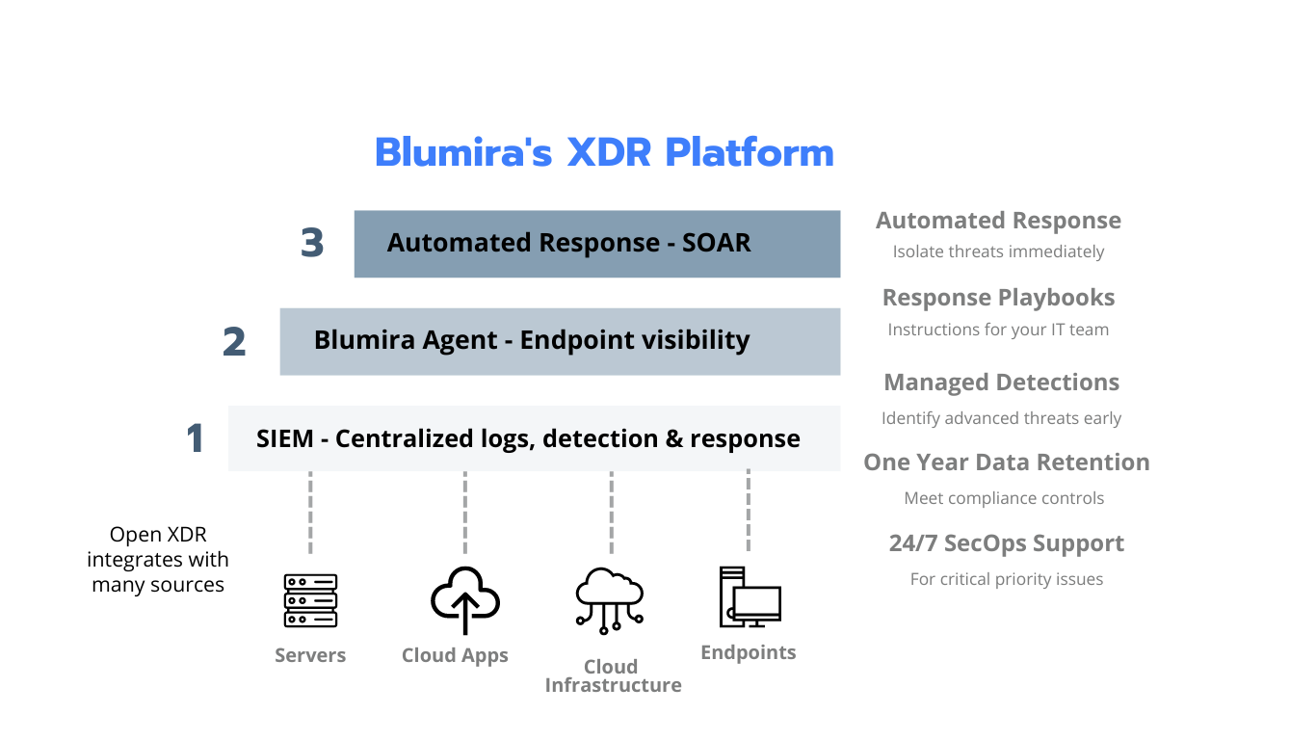
WHAT IS BLUMIRA XDR?
Blumira’s XDR Platform
Reduce complexity by consolidating security tools into one platform
Integrate broadly to provide insight across your entire environment
Use automation to speed up detection and response
Notes:
Blumira XDR combines endpoint visibility with automated response, powered by an advanced SIEM foundation to accelerate ransomware and breach prevention.

Slide 6


WHAT IS OPEN XDR?
Open XDR
Integrate with third-parties
Flexible as you grow
Coverage for modern hybrid IT
No vendor lock-in
vs. Native XDR
Must buy all 1 vendor’s solutions
Expensive, contract lock-in
Potential gaps in coverage
Built for the enterprise
Notes:
There’s additional differences between what’s called Open vs. Native XDR. Open XDR refers to platforms that support a wide variety of integrations with different tools from different vendors. Native XDR refers to more closed systems that mainly support one vendor’s toolset.
Blumira offers an open XDR to simplify security for SMBs, integrating with their third-party tools to provide greater flexibility and broader coverage for hybrid environments as they grow.

Slide 7
02
Blumira
XDR
Value

Slide 8
CHALLENGES
Small & medium-sized businesses struggle to protect their organization against ransomware and breaches
Time-Strapped
No 24/7 Team
Complexity
Managing security tools can require many manual tasks – threat hunting, managing rules, parsing data, developing integrations and more.
Small IT teams can’t be fully staffed around the clock due to costly enterprise solutions, talent shortage and lack of security expertise.
Too many disparate solutions results in redundancies and lack of visibility into remote endpoint risks.
“I don’t have the staff dedicated to sit and read logs all day or with the skillset to analyze our data.”
– Jim Paolicelli, IT Director, Atlantic Constructors
Notes:
Small and medium-sized organizations (100-1000 employees) with resource-strapped IT teams struggle to manage security for their hybrid environments due to lack of time, team capabilities and IT complexity.

Slide 9
BLUMIRA XDR VALUE
Blumira’s open XDR platform simplifies advanced detection and response for small and medium-sized businesses
EASY
EFFECTIVE
EFFICIENT
Free up time & refocus efforts
Faster time to security
Satisfy compliance & gain more visibility
Reduce reliance on humans to complete manual security tasks to achieve faster time to security
Accelerate breach prevention and ransomware protection with automated response
All-in-one open XDR platform simplifies workflows with hybrid coverage, satisfying more compliance controls
“I feel comfortable now that we don't have unknown activity happening on our network -- we now have full visibility of our infrastructure.” – John Hwee, Director of IT, Duraflame
Notes:
Blumira provides an accessible, simple and easy-to-use XDR platform that is easy, effective and efficient for SMBs.
They can save time with our platform – we take care of manual security tasks, at scale
They can achieve faster time to detect and respond by leveraging built-in automated response
They can also satisfy more compliance controls with our SIEM, endpoint visibility and SOAR capabilities and get more coverage for a hybrid remote workforce

Slide 10










Blumira delivers unique value to meet SMB needs:
BLUMIRA XDR PLATFORM
✓ FLEXIBILITY OF AN OPEN XDR
✓ AUTOMATION ACCELERATES SECURITY
Open platform supports multiple vendors for hybrid coverage of cloud, endpoint, identity, servers and more
Deploy in minutes; stop threats immediately with automated response to isolate devices and block malicious traffic
✓ MANAGED PLATFORM SAVES TIME
✓ SATISFY MORE COMPLIANCE CONTROLS
Blumira’s team manages the platform to do threat hunting, data parsing and analysis, correlation and detection at scale
Get more in one – SIEM w/1 year of data retention, endpoint, automated response & 24/7 SecOps support*
*For critical priority issues
Notes:
These are our differentiators vs. competitors –
– We offer an open XDR that’s vendor-agnostic, unlike many closed native XDRs on the market today
– Blumira is easy to use, automating threat detection and response to help you deploy quickly and contain threats faster (other vendors take 5x longer to deploy, with automated response as an expensive add-on)
– Our managed platform saves you time and effort to do threat hunting and other manual security tasks (other vendors require a steep learning curve to maintain and manage over time)
– We help you satisfy more compliance controls with one solution, from one year of data retention to endpoint visibility, log monitoring, detection and response (other vendors don’t offer a SIEM or retention)

Slide 11
03
How Blumira Works

Slide 12
HOW IT WORKS
Blumira analyzes threats with faster resolution to prevent a breach
1. USER ONBOARDING & LOG TRANSMISSION
2. DATA PROCESSING & THREAT DETECTION
PARSE DATA
SIGN IN
INSTALL AGENT
COLLECT LOGS
DEPLOY RULES
3. AUTOMATED RESPONSE + SUPPORT
ANALYZE THREATS
SURFACE FINDINGS
BLOCK THREATS
PLAYBOOKS
SECOPS SUPPORT
Blumira does the heavy lifting for you.
ALL-IN-ONE XDR PLATFORM:
SIEM + ENDPOINT + AUTOMATED RESPONSE
Notes:
A user can sign in & quickly set up an integration to send logs from their cloud applications to Blumira’s app (via API), or set up on-prem integrations using a sensor
Blumira applies detection rules automatically, starts to analyze logs for threats
Sends users notifications of findings with instructions on how to respond
Users can see more information about findings with pre-built reports and dashboards
Paid edition users can get more security features – get automated response, unlimited integrations, full support, etc.
Users can reach out directly in product to message our security team for help

Slide 13
BLUMIRA XDR PLATFORM
Fast, Easy & Automated
Deployment is 5x faster than the industry avg.*
Data is parsed, normalized, retained for 1 year
Logs are automatically analyzed for threats
Reduce Alert Fatigue
All findings are prioritized by level of criticality (P1-P3)
All correlated data are consolidated under initial findings and tuned or adjusted to reduce fatigue
Alerts sent within 50 seconds of initial detection for faster time to security
Fully Managed Detections
Blumira engineers tune and develop new detections to automate threat hunting
Platform updated regularly to protect against new threats
Customers can filter alerts based on known safe activity to reduce noise
SIEM + MANAGED DETECTIONS
Notes:
The first step to XDR is Blumira’s cloud SIEM as the core foundation of your platform.

Slide 14
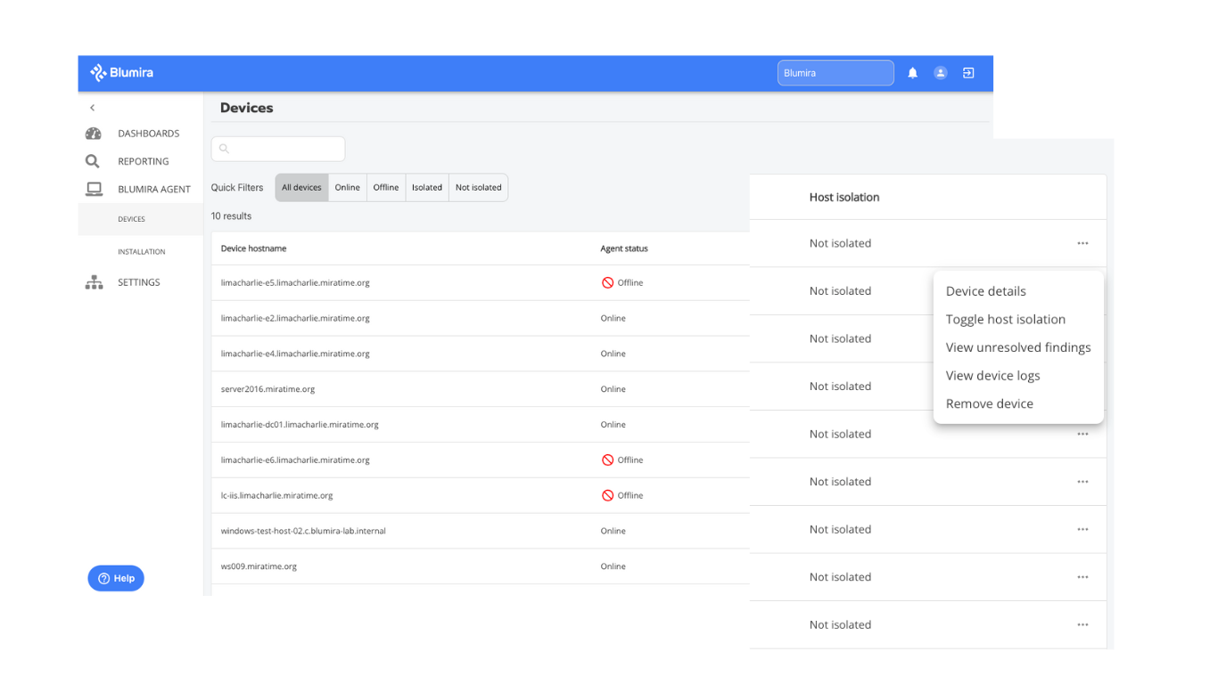
BLUMIRA XDR PLATFORM
Support Remote Work
Blumira Agent extends coverage to Windows endpoints located anywhere
Fast, easy to deploy in minutes – no infrastructure required
Lightweight, minimal impact to your environment
Detect & Contain Threats Immediately
Device/host isolation to automatically contain an identified threat
Protect your network from a ransomware attack
ENDPOINT VISIBILITY
WITH BLUMIRA AGENT

Slide 15
BLUMIRA XDR PLATFORM
Automated Host Isolation
Blumira Agent immediately isolates an endpoint from your network when a critical threat is identified
Automated Blocking
Automatically block traffic from known malicious IP addresses
Dynamic blocklists use updated threat feeds integrated with your firewall to identify threat sources
Response Playbooks
Automatically sent with every finding
Guide your IT team through easy remediation steps
24/7 SecOps Support
Access to a responsive security team for critical priority issues
Get security guidance, onboarding help and answer any questions about findings
AUTOMATED RESPONSE

Slide 16
BLUMIRA XDR PLATFORM
Blumira’s open XDR platform simplifies detection & response, accelerating ransomware and breach prevention.
EASY
Free up time & refocus efforts
EFFECTIVE
Faster time to security
EFFICIENT
Satisfy compliance & gain more visibility

Slide 17
Features
Free SIEM
SIEM Pro
SIEM + Endpoint Visibility
XDR Platform
Data retention | 14 days | 30 days | 1 year | 1 year +
Cloud integrations | Pick 3 | ✓ All | ✓ All | ✓ All
Sensor integrations |  | ✓ All | ✓ All | ✓ All
Logging & analysis | ✓ | ✓ | ✓ | ✓
Managed detections & playbooks | ✓ | ✓ | ✓ | ✓
Filter detections for noise |  | ✓ | ✓ | ✓
Blumira Agent / manual isolation |  |  | ✓ 1/user + | ✓ 1/user +
Automated host isolation / blocking |  |  |  | ✓
Honeypots |  |  | ✓ | ✓
Dashboards & reporting | Only basic | ✓ | ✓ | ✓
24/7 support critical issues |  | ✓ | ✓ | ✓
Notes:
Free – Start to see value right away by setting up 3 cloud connector integrations to stream logs to Blumira’s SIEM platform for analysis, detection and response
SIEM Pro – Get access to all cloud and on-prem (sensor) integrations, 24/7 SecOps support for critical priority issues, advanced reporting and the ability to filter your own detection rules for noisy alerts
SIEM + Endpoint Visibility – Get everything in SIEM Pro, easily meet compliance with 1 year of data retention, plus 1 Blumira Agent per user for endpoint visibility and response; and access to honeypots to detect unauthorized access attempts
XDR Platform – Get complete access to the full suite of products – SIEM + Endpoint Visibility + Automated Response – block threats automatically on endpoints and from known malicious sources with automated host isolation and automated blocking

Slide 18
Additional Product
Information
Notes:
Addendum – optional slides to show as needed (to see specific integrations, product UI, sign up for Free edition, etc.)

Slide 19


How Blumira Works
Collect
Parse
Correlate
Analyze
Detect
Automated Response
Notify
Playbooks
Respond
Cloud Connector
OR
Port 443
Security Tools
Endpoint logs from Blumira Agent
Virtual Sensor
Automated Response
Playbook Response
Notifies Customer
Threat Hunting
Detections
Threat Intel
Customer Responds
Notes:
Logs are sent to Blumira’s sensor and/or via Cloud Connector
Blumira’s sensor parses the logs
Parsed logs are sent to Blumira’s cloud service over port 443
Threat intelligence is correlated to logs
Blumira’s rule-based detections trigger a response
Threat hunting triggers a response
An automated response is taken by Blumira – isolate an endpoint automatically or block malicious traffic
Blumira’s platform notifies the customer, providing a playbook on what actions to take in response
Customer follows playbook steps and initiates/completes response

Slide 20




























Open XDR Integrates With Any Service
Cloud Infrastructure
Endpoint
Productivity
Host
Firewall
See complete list of integrations at blumira.com/integrations
Notes:
Connect to every service in your hybrid environment for comprehensive, vendor-agnostic coverage with Blumira’s open XDR platform.

Slide 21



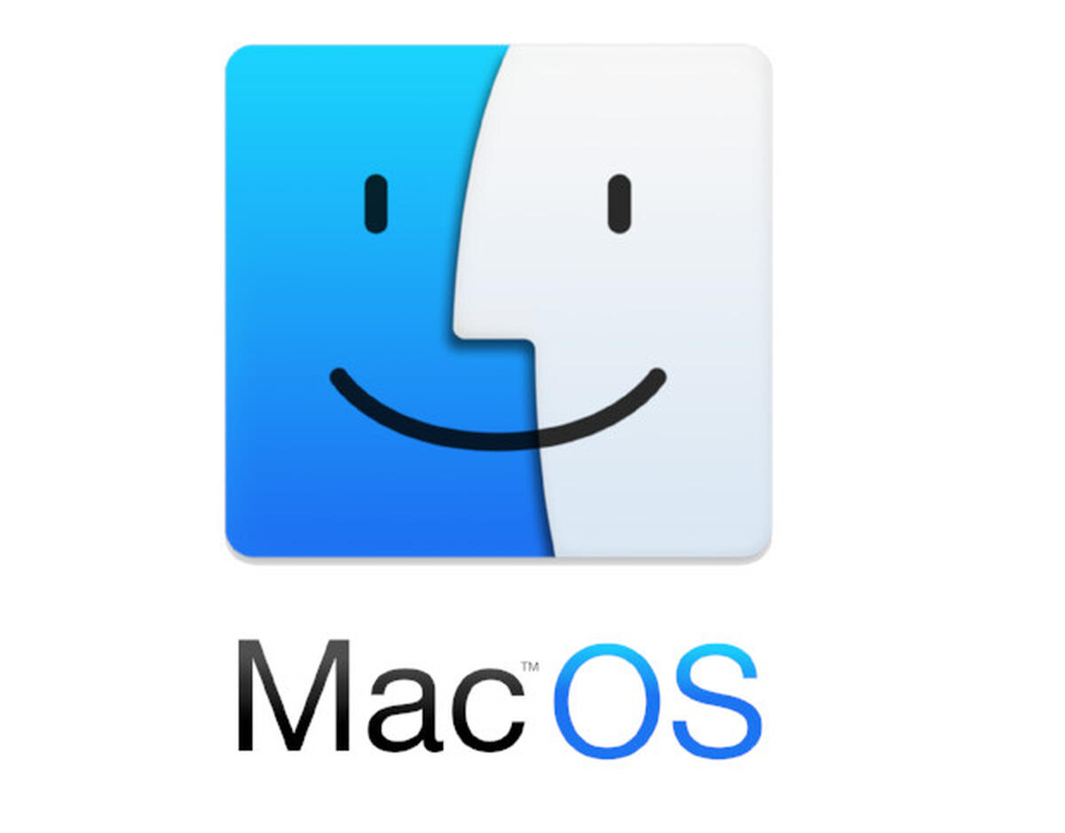







Open XDR Integrates With Any Service
Additional Integrations
See complete list of integrations at blumira.com/docs

Slide 22
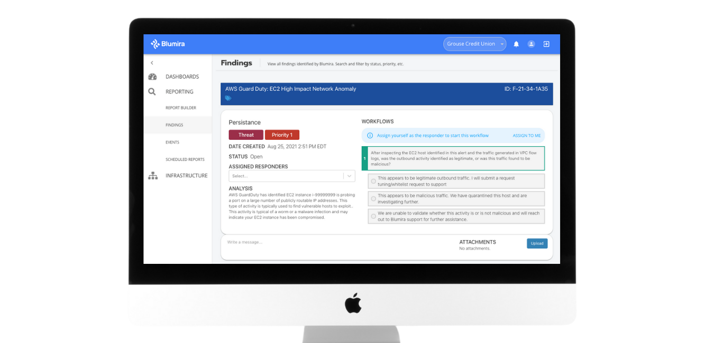
Security Finding
Response Playbooks
Threat Level
Assign Responder
Threat Analysis
Ask an Expert
Example Finding
Notes:
Here’s an example of a security finding that your team will see in Blumira’s platform.
They get an alert prioritized by threat level to understand the criticality
This includes a simplified threat analysis, with all relevant and contextual information on who, what, where
It’s easy to choose a team member to assign as a Responder
We provide a security playbook to help Responders take the next steps toward remediation (no security expertise required)
If you have automated response set up, Blumira will immediately isolate affected endpoints or block malicious traffic
If you need more information, reach out to Blumira’s responsive security team for advice

Slide 23
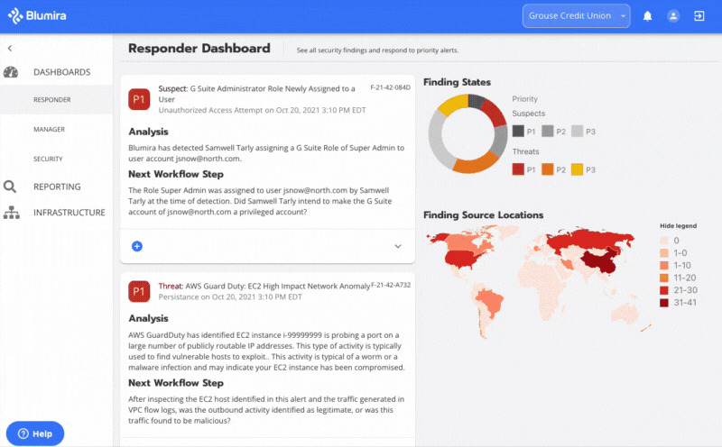
See Blumira’s XDR Platform in Action
Automated extended threat detection & response
Prioritized findings give you a full analysis of the threat
Workflows for every finding tell you how to respond
Correlated data sent with findings to help with investigation

Slide 24
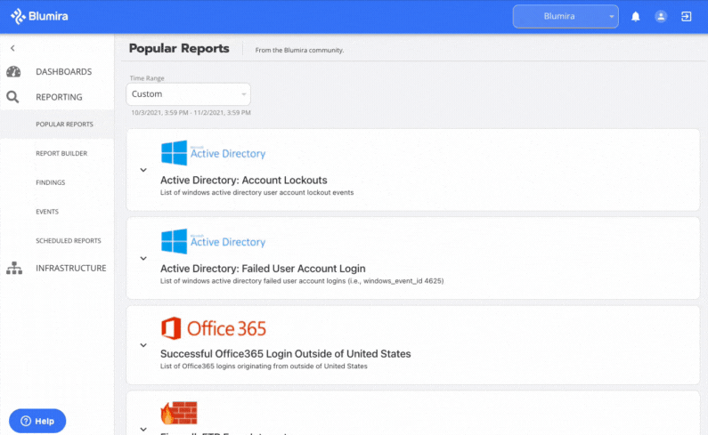
See Blumira’s XDR Platform in Action
Easy-to-Use Security Reports With Click-Through Dashboards
Scheduled security reporting is included
Drill down into account lockouts, failed user logins and more
Click-through dashboards provide customizable search through your data, filtered by data source

Slide 25


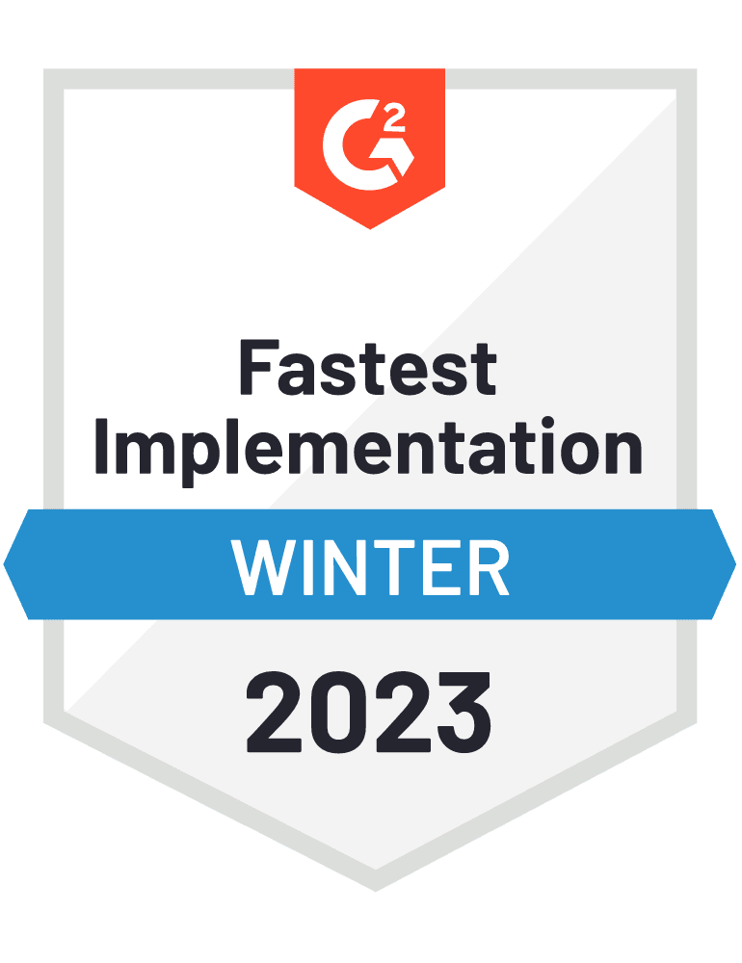

Try Blumira
Sign up for Blumira’s Free SIEM
Unlimited users and data, no credit card or special licensing required.
Contact us for an XDR trial
Try out the XDR platform today!
Visit blumira.com/free to start.

